Slide 1

Memory hierarchy
Presented to Bijay Sahani presented by Aashish Subedi and Nischal Magar

Slide 2
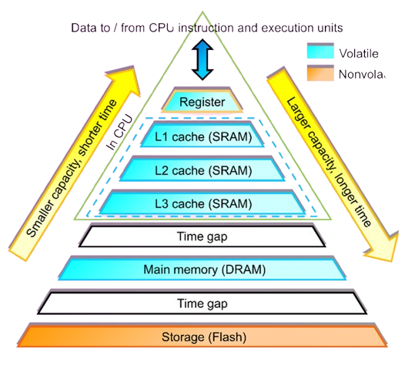

Computer memory hierarchy diagram

Slide 3
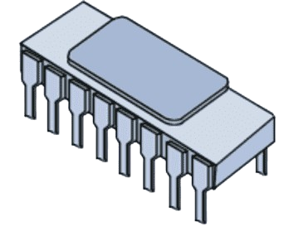
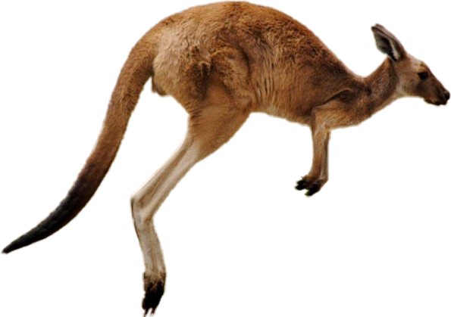
Level 0 (register)
Location: Inside the CPU.
Speed: Fastest form of memory.
Size: Very small (typically 32 or 64 bits).
Function: Stores data needed immediately for processing (e.g., intermediate results, control information).
Access: Direct, high-speed access by the CPU.
Importance: Crucial for fast instruction execution and overall CPU performance.
Fig: Register

Slide 4
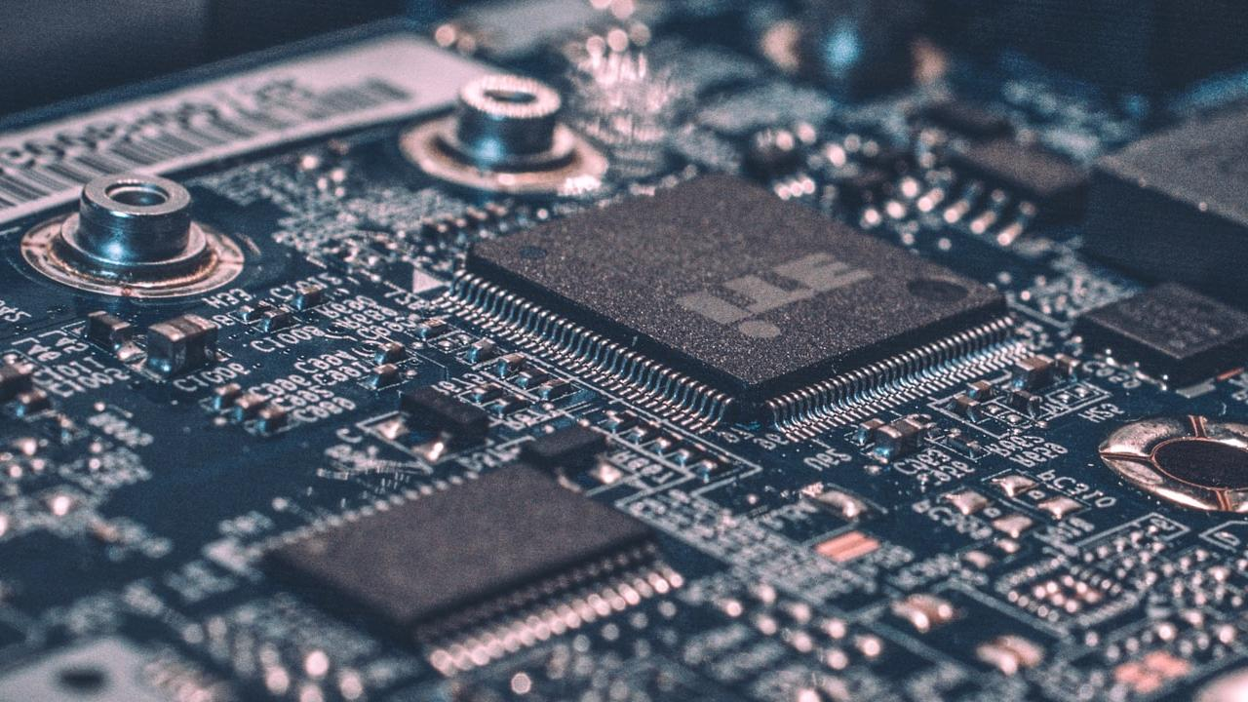
Level 1 (Cache)
Priority: Acts as the first buffer in the memory hierarchy.
Speed: The fastest memory type, ideal for quick data access.
Size: Small, usually between 16KB and 128KB.
Location: Located directly on the CPU for minimal delay.
Split: Often divided into Instruction Cache and Data Cache.
Fig: Cache

Slide 5
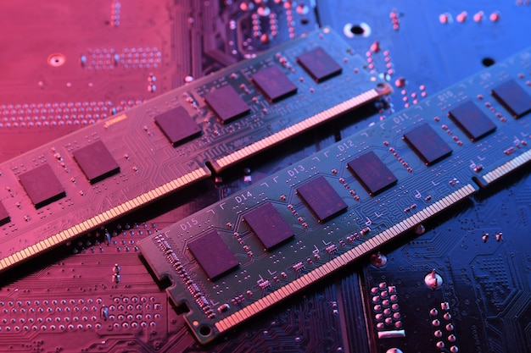
Level 2 (Main Memory/ primary Memory)
Speed: Slower than L1 Cache, but still much faster than main memory (RAM).
Size: Larger than L1 Cache, typically ranging from 256KB to 8MB.
Location: Situated between L1 Cache and the CPU, often on the CPU chip or on a separate chip close to the CPU.
Unified Cache: Generally not split into instruction and data caches, unlike L1.
Backup: Acts as a secondary buffer, holding data that overflows from L1 Cache, reducing the time to fetch data from main memory.
Fig: RAM

Slide 6
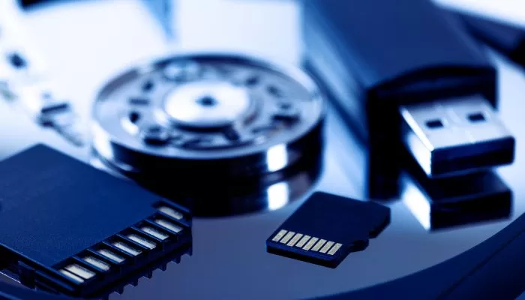
Level 3 (secondary Memory)
Speed: Slower than L1 and L2 Caches, but still faster than main memory (RAM).
Size: Much larger than L1 and L2, usually ranging from 1MB to 32MB or more.
Location: Typically located on the CPU chip, shared among multiple processor cores.
Unified Cache: Acts as a unified cache for both instructions and data, without separation.
Last Resort: Serves as a final caching layer before data is fetched from main memory, improving overall system performance.
Fig: Secondary Memory

Slide 7

Level 4 (tertiary Memory)
Speed: Slower than L1, L2, and L3 but faster than main memory.
Size: Larger, ranging from tens of megabytes to gigabytes.
Location: Separate from the CPU, often shared across processors.
Unified: Not split, stores both instructions and data.
Performance: Additional buffer to boost memory access efficiency.
Fig: Tertiary Memory

Slide 8

Any Questions ?
Thank You

